Slide 1
CSCE 5290 Natural Language Processing
Group-7 Project
Multilingual Sentiment Analysis for Global Business Understanding
Team Members:
Pravallika Chava - 11654243
Hemanth Sai Mandava - 11633576
Praharsha Mutyala - 11712768
Bhavani Navari - 11656600

Slide 2
Table Of Contents
1.Introduction
2.Problem statement/Hypothesis
3.Model/Methodology
4.Project Flowchart
5.Dataset
6.Exploratory data analysis
7.Implementation
8.Results
9. Project Management
10.References/Bibliography

Slide 3
Introduction
Multilingual Sentiment Analysis for Global Business Understanding" is a crucial tool for businesses operating in contexts.
By developing advanced sentiment analysis models, companies can understand customer feedback of language barrier, the gap between different cultural backgrounds.
This approach enables businesses to prioritize customer opinions, look after a more inclusive and customer-centric environment.

Slide 4
Problem statement/Hypothesis
In the globalized e-commerce, businesses face different challenges in understanding different region’s customer feedback due to human input, which covers language's units, nature, structure, and alteration.and cultural differences. For instance, an Italian business owner may struggle to interpret feedback from Japanese users or comments from German buyers understood by Brazilian craftsmen. To address this, we propose developing a sentiment analysis model capable of accurately evaluating multilingual comments, thereby enabling businesses to better understand and connect with their international customer base.

Slide 5
Model/Methodology
This sentiment analysis project leverages machine learning models and NLP techniques to evaluate and classify customer reviews across multiple languages.
Key libraries we used are NLTK, scikit-learn, and Pandas are utilized for data cleaning and analysis. The process involves tokenization, normalization, and TF-IDF Vectorization for feature extraction. Machine learning classifiers such as Random Forest and Logistic Regression are employed, alongside advanced models like BERT, to capture nuances in language. Additionally, the inclusion of emoji handling enhances the model's accuracy in interpreting sentiment from reviews

Slide 6
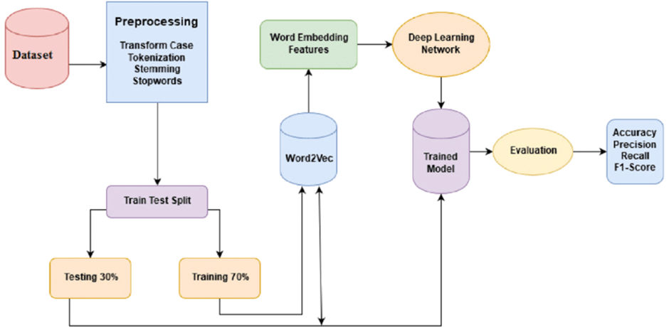
Project Flowchart

Slide 7
DATASET
There are sixty thousand assessments in all, and each appraisal has the same amount of reviews in the six languages (English, Spanish, French, German, Japanese, and Chinese), for a total of ten thousand reviews each appraisal. This equal distribution is essential for our sentiment analysis model so that it can accurately recognize attitudes in a variety of linguistic contexts and no language becomes more prevalent than another.

Slide 8
DATA FIELDS
1. review_id: The review's string identifier.
2. product_id: The product's string identifier that is being evaluated.
3. Reviewer ID: An identifying string for the reviewer.
4. Stars: An integer representing the star count, ranging from 1 to 5.
5. review_body: The review's main body of text.
6. Review title: The review's text title.
7. Language: The review language's string identification.
8. Category of product: A string representation of the category of the product.

Slide 9
EXPLORATORY DATA ANALYSIS
They need to have a solid understanding of the dataset provided by the exploratory data analysis (EDA) conducted for the sentiment analysis project in order to comprehend the distribution and nature of the data. This section describes our approach and the EDA process's conclusions.

Slide 10
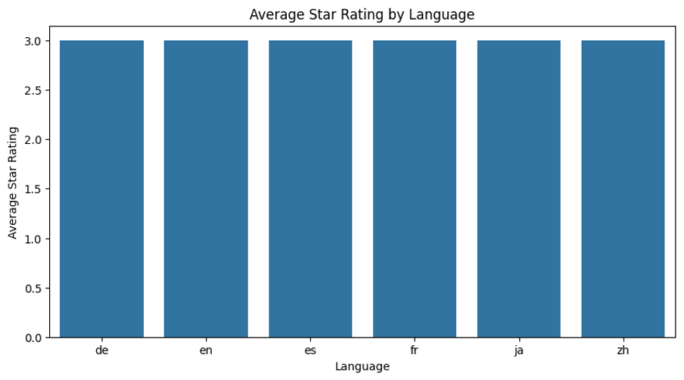
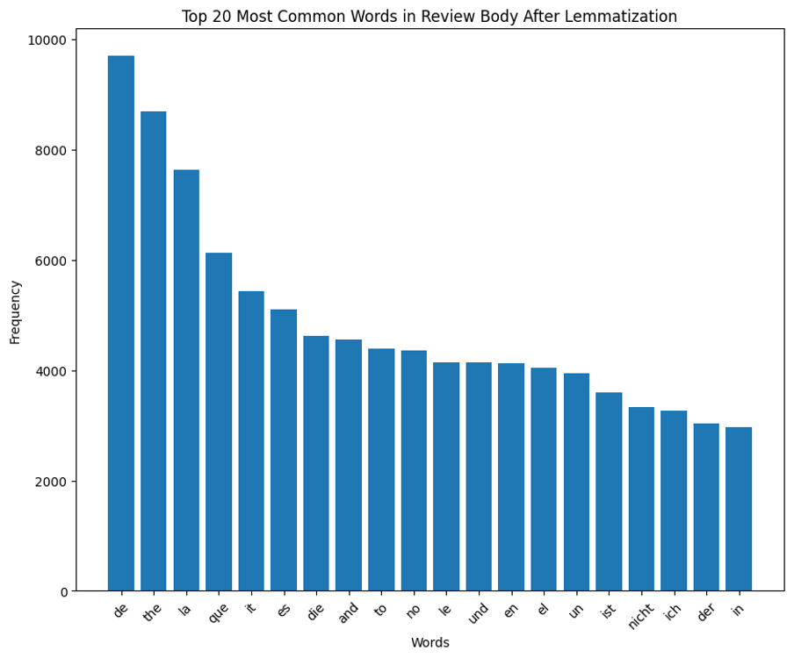
DATA VISUALIZATION
Since the average star ratings in each language were distributed nearly evenly around the mid-scale, it can be said that no one language in our sample exhibits sentiment bias. Because of their cross-linguistic commonalities, this means that the sentiment analysis model won't be skewed towards more favorable or negative ratings in any of these languages: German (de), English (en), Spanish (es), French (fr), Japanese (ja), and Chinese (zh). This demonstrates how carefully selected dataset can be used to build robust sentiment analysis systems independent of language.
The bar graph that shows the most often recurring terms in our reviews represents the language landscape, which is dominated by short yet effective "stopwords." These language industry standard bearers, "the," "and," "la," and more, serve as the connecting element in customer feedback. Interestingly, the presence of these frequent phrases even after lemmatization implies that reviews have a shared language substrate independent of content. This highlights the critical need to enhance our sentiment analysis tools to enable them to look beyond these linguistic cues and investigate the more expressive domains that genuinely impact sentiment.

Slide 11
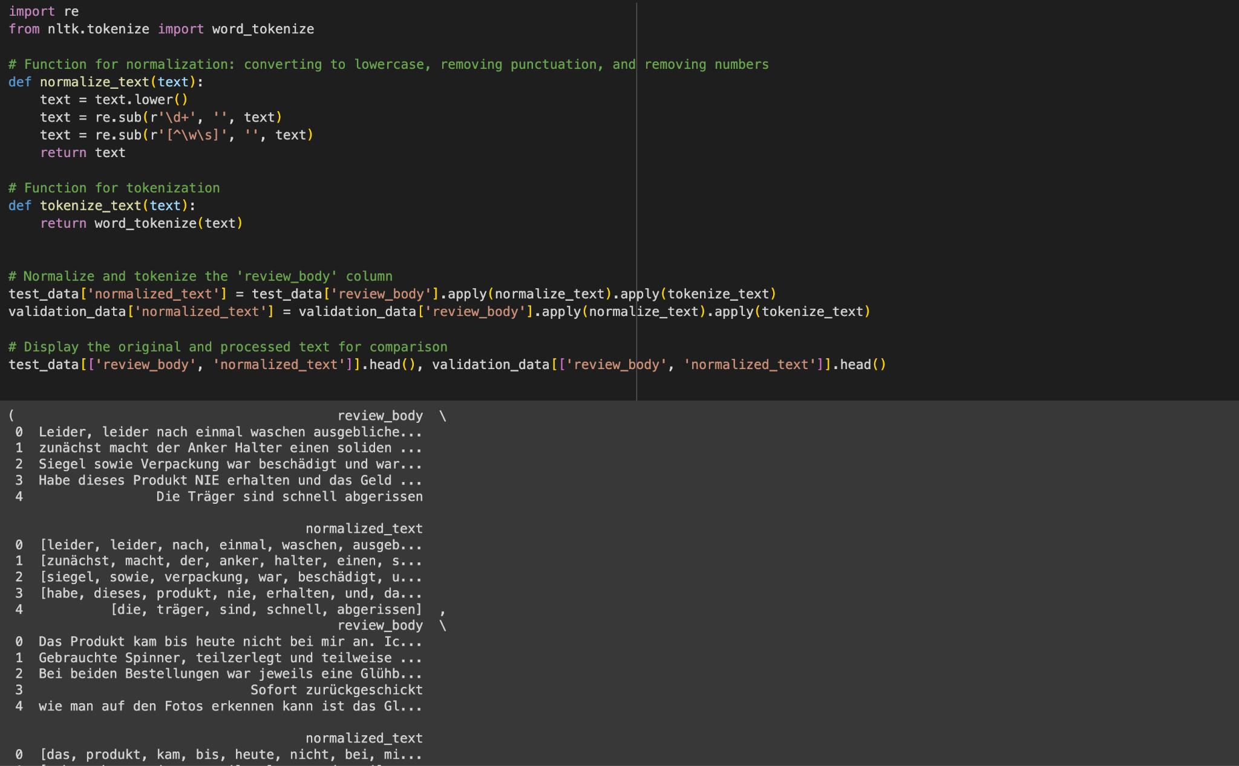
DATA PREPROCESSING
Preparing the data for training was the first step in the implementation process to guarantee high-quality inputs. Dealing with missing values and recognizing brief reviews that cannot be examined were two important steps in the process. After the sentences were tokenized and normalized, we used TF-IDF vectorization to extract features from the review texts.

Slide 12
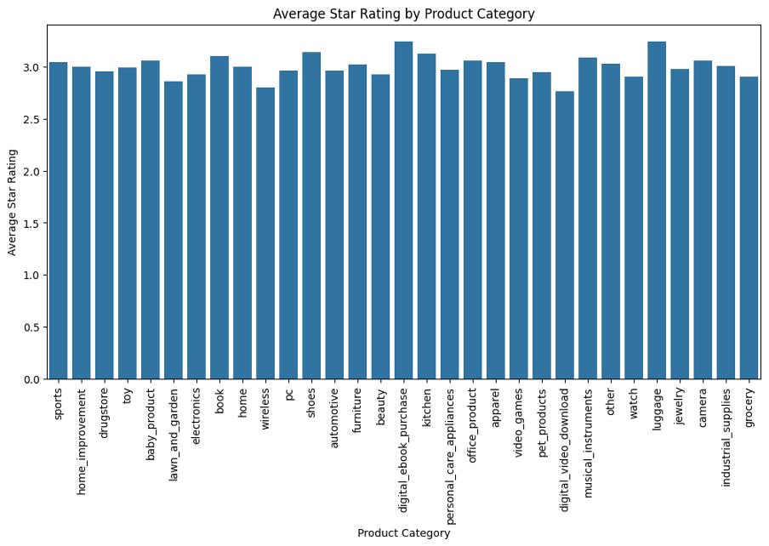
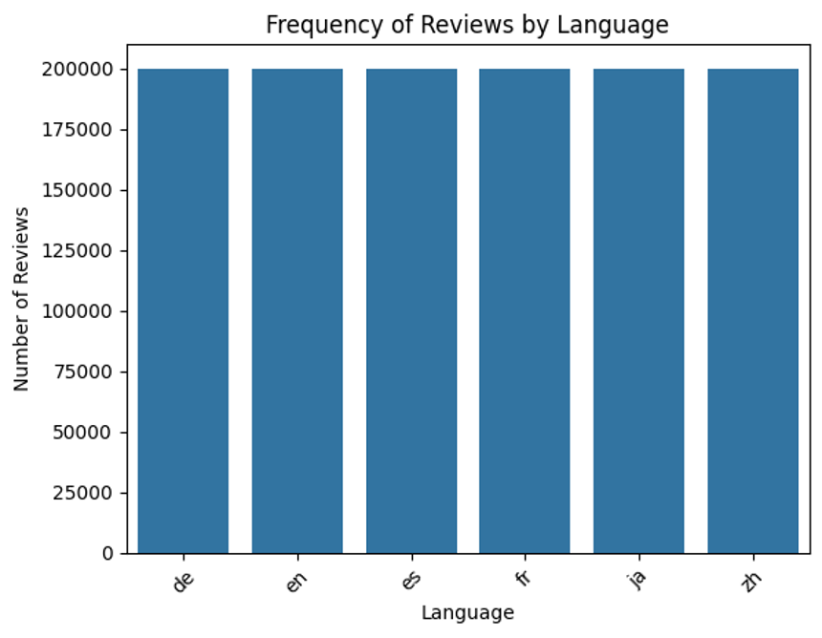
BAR CHARTS
Our bar graph, which displays the average star ratings for a number of categories, including sports and personal hygiene, shows a mostly level landscape with very few outliers. Interestingly, customer satisfaction is substantially lower for "sports" and "home improvement" but marginally higher for categories like "luggage" and "digital_ebook_purchase." Businesses may be able to address some issues within their industries if the explanation of these differences in customer perception sparks curiosity regarding the causes.
The bar chart displays an equal distribution of evaluations among the six languages to ensure that no language is more emotive than any other in our investigation. This balance is essential because it allows us to optimize our sentiment analysis model to identify sentiments in Mandarin and Spanish equally well, promoting a more comprehensive understanding of client emotions worldwide.

Slide 13
Algorithms
After normalizing and tokenizing the data, we used different algorithms which have a high accuracy in performing Natural Language Processing Tasks such as Logistic Regression, Random Forest Classifier and a pre-trained BERT model. By doing so we achieved a decent level of accuracies for all these algorithms. We trained them with pre-processed data after we have initialized the TF-IDF Vectorizer.

Slide 14
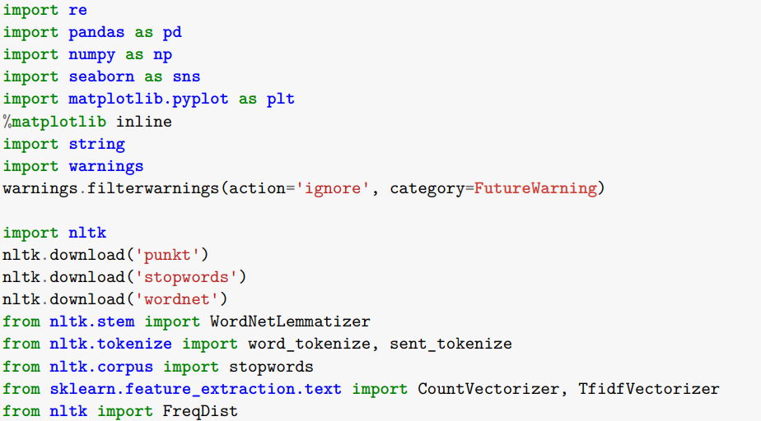
Implementation Libraries:
Some useful libraries were crucial to the implementation process including;
nltk used for NLP tasks like tokenization and lemmatization.
scikit-learn employed for TF-IDF vectorization and model training related with machine learning.
gensim – an added supplement for working with text along with vector space modeling.
transformers as well as datasets by Hugging Face to cater to pre-trained BERT models.

Slide 15
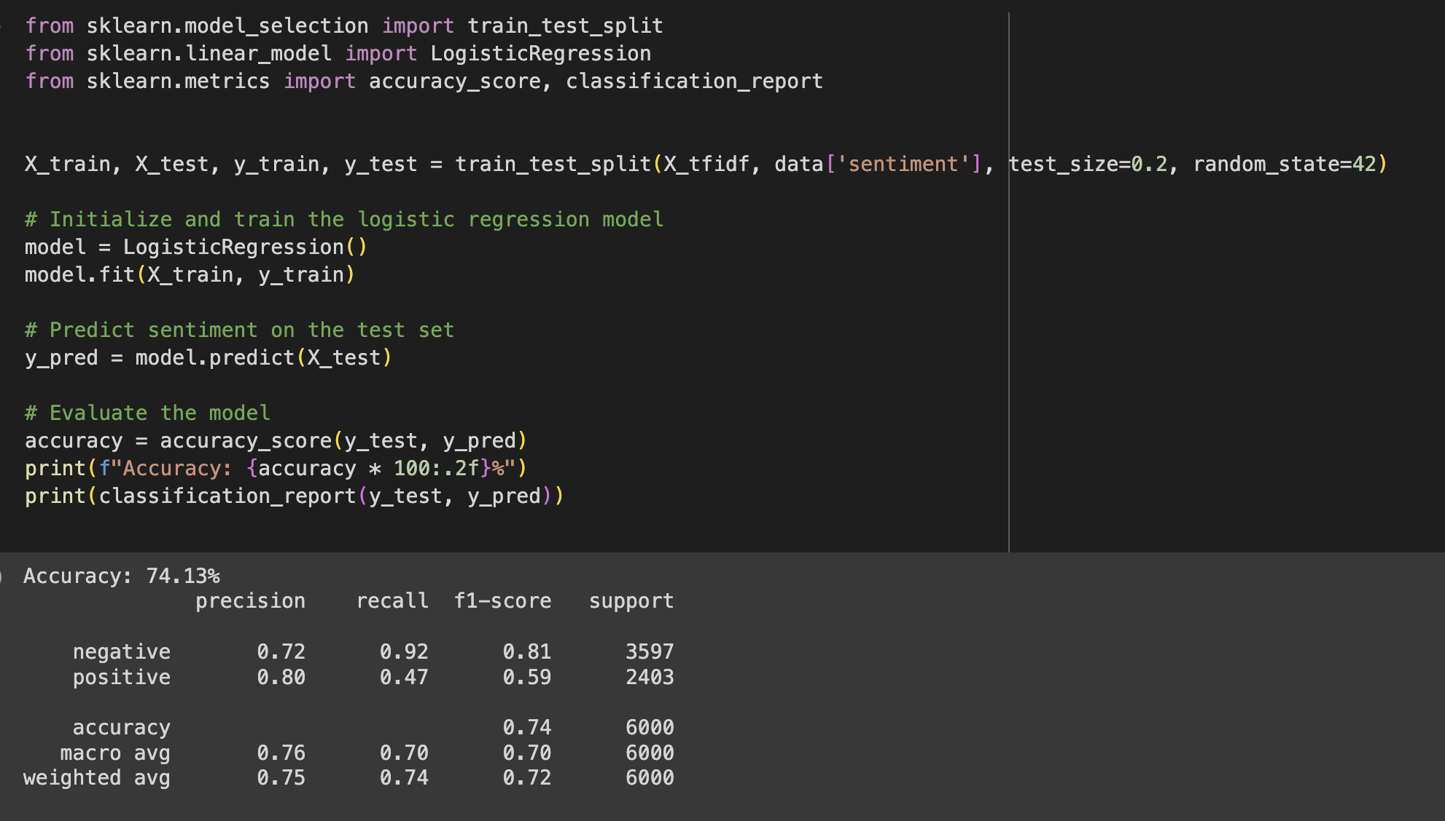
Implementing the Logistic Regression Model
After initializing the TF-IDF Vectorizer, we trained the Logistic Regression Model for that firstly we splitted the data into training and validation parts and then trained the model with the training data and after that predictions were made on the sentiment data and lastly the model is evaluated based on its accuracy, precision and f1-score.

Slide 16
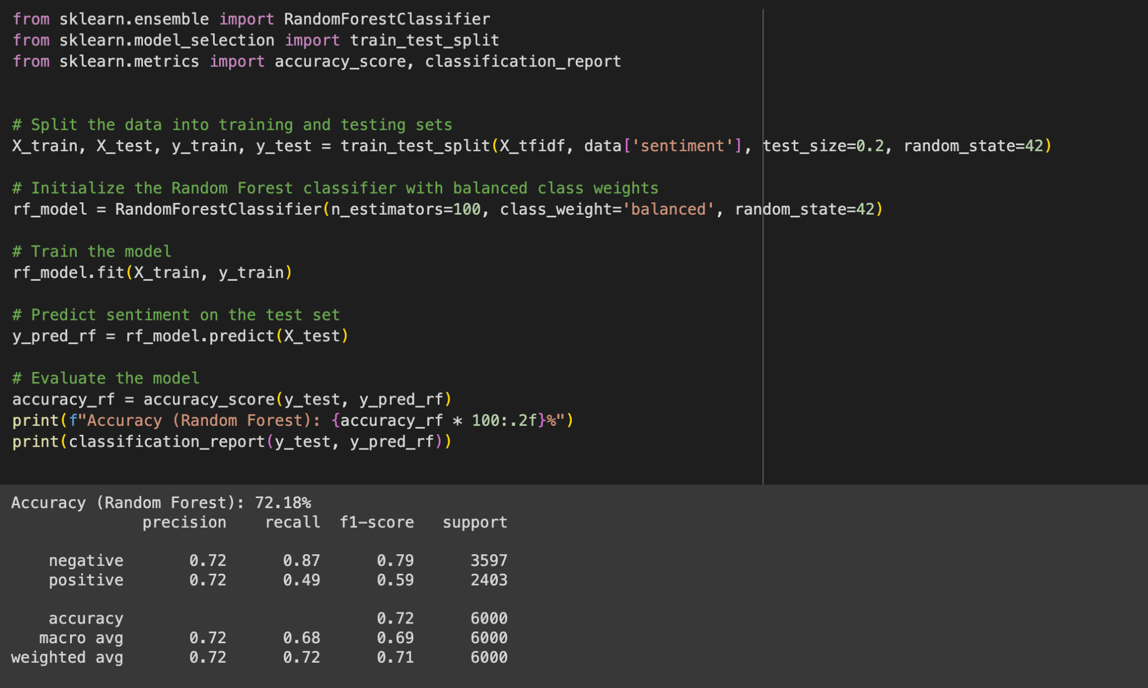
Implementing the Random Forest Classifier
After training the Logistic Regression Model, We trained the Random Forest Model for that firstly we splitted the data into training and validation parts and then trained the model with the training data and after that predictions were made on the sentiment data and lastly the model is evaluated based on its accuracy, precision and f1-score.

Slide 17
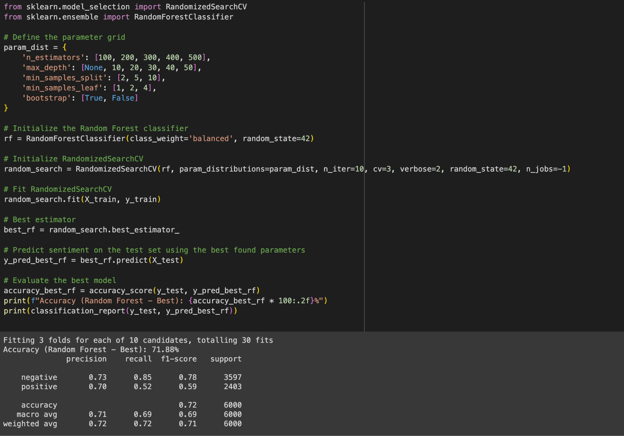
Improving the Random Forest Classifier
We tried to improve the previously trained random Forest Classifier by performing hyperparameter tuning. In this we defined the grid for the parameters and initialized randomized search to have balanced weights and initialized the cross validation to enable faster processing of data using parallel processing after that fitted the training and validation data to the improved classifier and made predictions on it and evaluated the better model between the Old Random Forest Classifier and the tuned Random Forest Classifier.

Slide 18
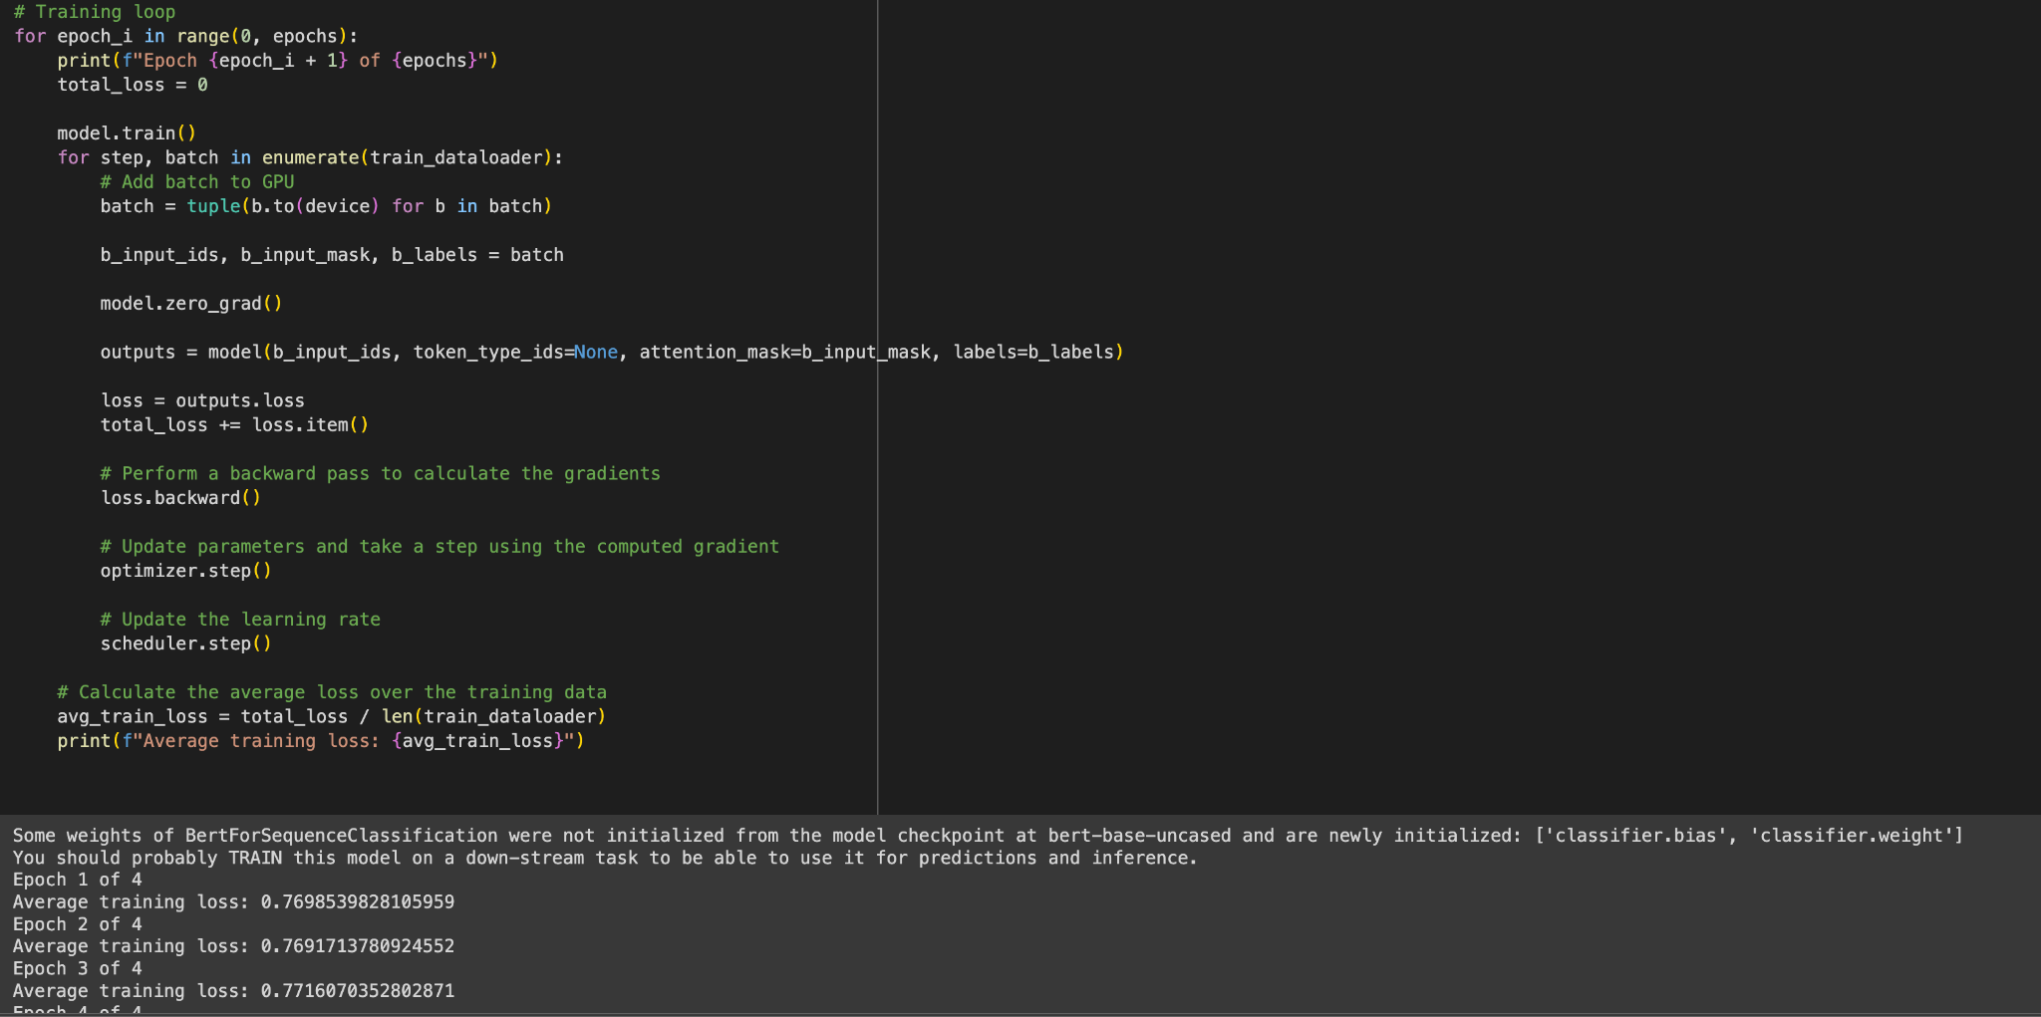
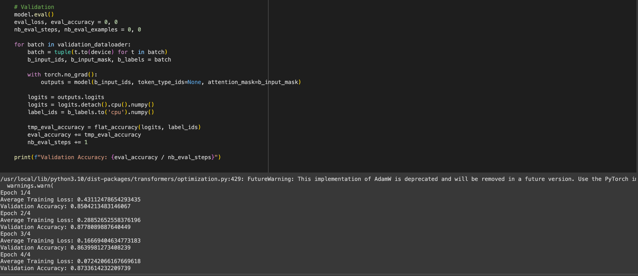
Implementing the BERT model
For implementing the BERT model as it is a pre-trained model we are preparing the dataset to be able to use as training and validation data on BERT using data loader, setted an optimizer for the said data, later loaded the pre-trained BERT model and created a loop for training and calculated the loss later fine tuned the model and printed the evaluation metrics. The results suggest an effective adaptation of the model to the task, showcasing a balance between learning from the training data and maintaining performance on unseen data.

Slide 19
Results
Performance Measures: The ability of the sentiment analysis models to accurately identify the sentiment from the textual reviews was the basis for their evaluation. The following measures were used to assess the models' performance: accuracy, precision, recall, and F1-score:
Model of Logistic Regression:
74.13% accuracy Precision: 0.75 (weighted average), 0.76 (macro average) Recall: 0.70 (weighted average), 0.74 (macro average) F1-Score: 0.72 (weighted average), 0.70 (macro average)

Slide 20
RESULTS:
The Random Forest Classifier
72.18% accuracy
Precision: 0.72, 0.72
Recall: 0.68 , 0.72
F1-Score: 0.71 , 0.69
Random Forest Classifier with RandomizedSearchCV fine-tuned:
71.88% accuracy
Precision: 0.72, 0.71
Recall: 0.69, 0.72
F1-Score: 0.71, 0.69
BERT Model:
87.33% accuracy

Slide 21
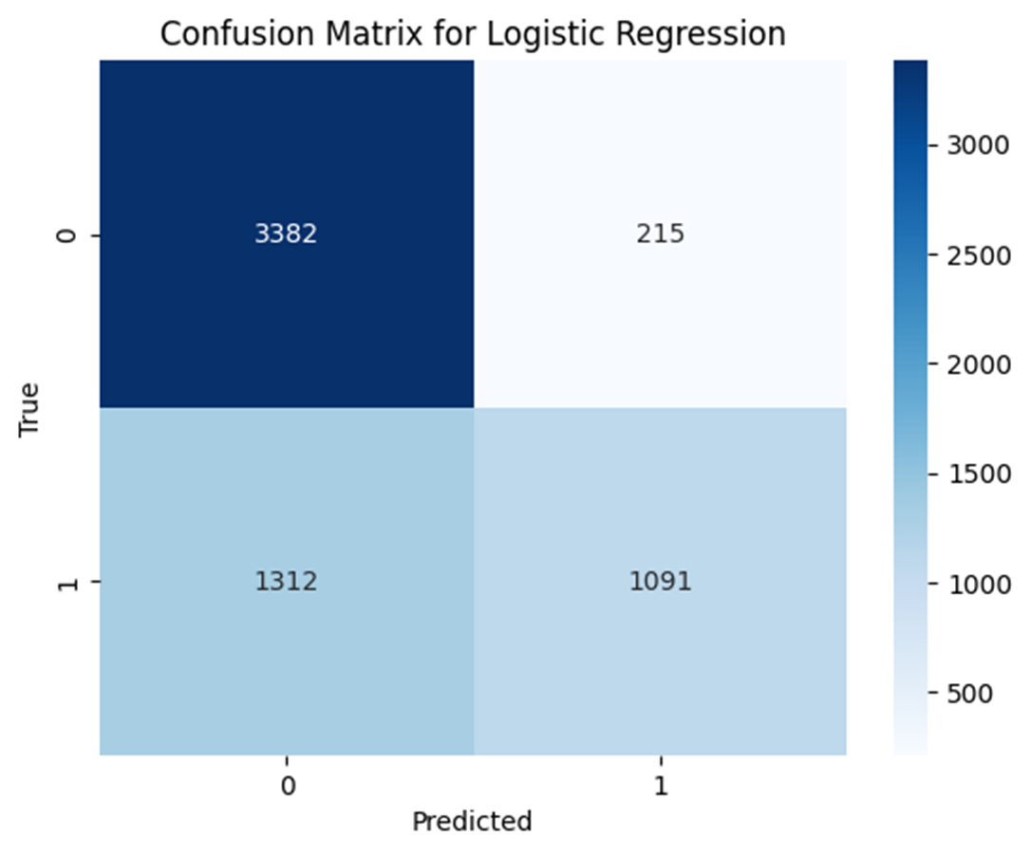
Confusion Matrix for Logistic Regression
This distinguishes true positives (1091) and true negatives (3382) from false positives (215) and false negatives (1312), showing that the model accurately forecasts negative class, yet a significant number of false negatives indicate that increased model’s sensitivity to accurately identify positive cases could improve diagnosis.

Slide 22
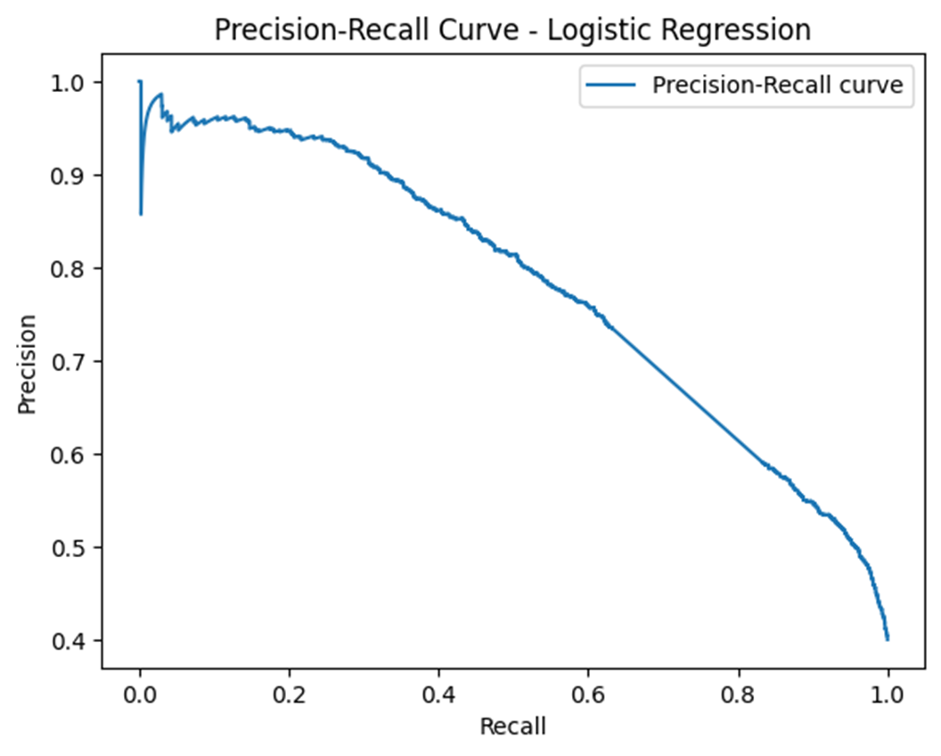
Logistic Regression Precision-Recall Curve
The logistic regression model's impact on recall varies with precision across different thresholds on the precision-recall curve. This behavior is typical because prioritizing the capture of more true positives often leads to lower accuracy. At low recall levels, the model exhibits good precision, indicating strong confidence in positive predictions. However, precision diminishes when attempting to capture additional positive cases.

Slide 23
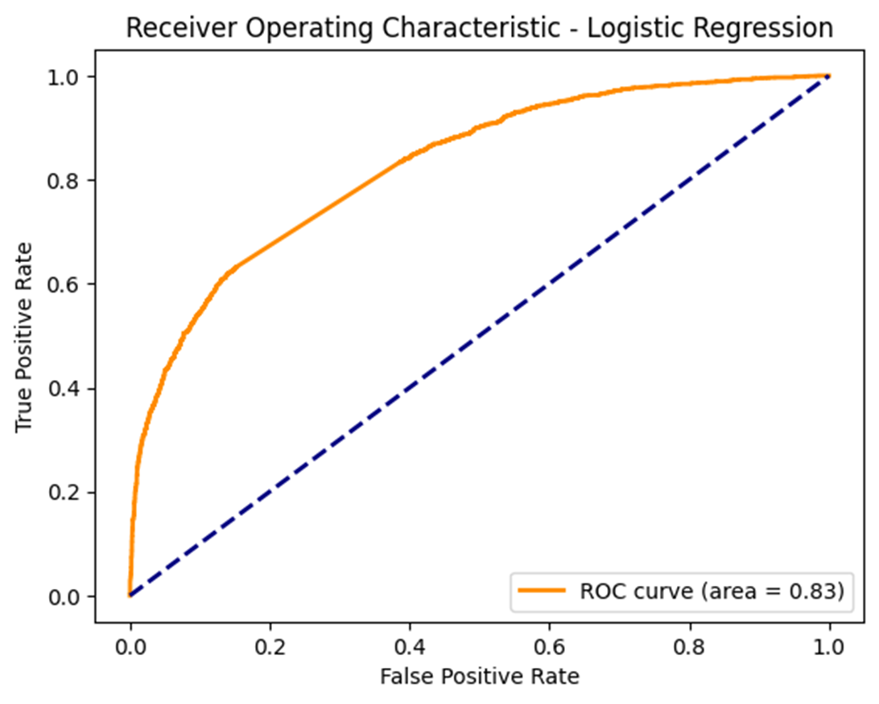
Receiver Operating Characteristic for Logistic Regression
The ROC curve visually represents how well a logistic regression model performs across all classification thresholds. With an AUC of 0.83, indicating a high True Positive rate compared to the False Positive rate, the model demonstrates efficiency. It's most accurate when the curve hugs the upper-left corner, signaling superior performance. The curve's distance from the no-skill classifier line (dotted) indicates the model's skillfulness, positioned notably above the baseline.

Slide 24
Project Management
Implementation Status Report - Contributions
Member | Contribution % | Role Description
Hemanth Sai | 25% | Led data cleaning and normalization processes.Oversaw the fine-tuning of the BERT model.
Bhavani | 25% | Worked on tokenization and identifying short reviews.Executed feature extraction
Pravallika | 25% | Conducted EDA and produced visualizations for insights and assisted in hyperparameter tuning.Executed feature extraction
Harsha | 25% | Done initial model training.Conducted model validation and testing.
Some of the tasks that were done in the project included data preprocessing, exploratory data analysis (EDA), model training and fine-tuning, validation, and testing. Each phase was crucial for building a successful multilingual sentiment analysis model.

Slide 25
Issues/Concerns :
Model Interpretability: we have the complexity with machine learning models like BERT may provide high accuracy but lack interpretability, making it challenging to understand how they arrive at their predictions.
Noise in Text: Customer reviews mostly contain noise such as spelling errors, grammatical inconsistencies, slang, and sarcasm, which can affect the accuracy of sentiment analysis.
Data Quality: While doing this project we have the issue with quality of the data, accuracy, completeness, and relevance of customer reviews, can significantly impact the effectiveness of the sentiment analysis model.

Slide 26
References:
Zheng, L., Jin, P., Zhao, J., & Yue, L. (2014). Multi-dimensional sentiment analysis for large-scale E-commerce reviews. In Database and Expert Systems Applications: 25th International Conference, DEXA 2014, Munich, Germany, September 1-4, 2014. Proceedings, Part II 25 (pp. 449-463). Springer International Publishing.
Qorich, M., El Ouazzani, R. Text sentiment classification of Amazon reviews using word embeddings and convolutional neural networks. J Supercomput 79, 11029–11054 (2023).
Manias, G., Mavrogiorgou, A., Kiourtis, A. et al. Multilingual text categorization and sentiment analysis: a comparative analysis of the utilization of multilingual approaches for classifying twitter data. Neural Comput & Applic 35, 21415–21431 (2023).
Katić, T., & Milićević, N. (2018, September). Comparing sentiment analysis and document representation methods of amazon reviews. In 2018 IEEE 16th
International https://api.elsevier.com/content/abstract/scopus_id/85057962196
symposium on intelligent systems and informatics (SISY) (pp. 000283-000286). IEEE. https://ieeexplore.ieee.org/abstract/document/8524814/
Wendland, A., Zenere, M., & Niemann, J. (2021). Introduction to text classification: impact of stemming and comparing TF-IDF and count vectorization as feature
extraction technique. In Systems, Software and Services Process Improvement: 28th European Conference, EuroSPI 2021, Krems, Austria, September 1–3, 2021, Proceedings 28 (pp.
289-300). Springer International Publishing. https://link.springer.com/chapter/10.1007/978-3-030-85521-5_19

Slide 27
Thank You

